Slide 1
A Regional Model for Childcare in the Wheatbelt
Presenter Fleur Wilkinson
Shire of Brookton

Slide 2
Early Childhood Education and Care = “Childcare”

Slide 3
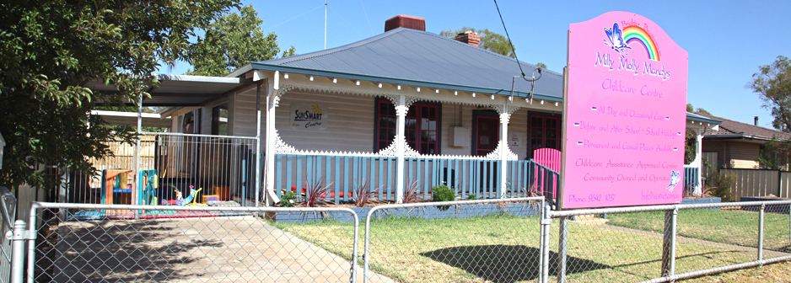

Background
Began using local Childcare “Milly Molly Mandy’s” in Brookton in 2001
Became a committee member one month later
Have held Treasurers position on and off for 5 or 6 years in total
Chairperson for less than two years before burning out
Supported Committee through the Shire for 5 years

Slide 4
Volunteer Management Committee Responsibilities
Committee
HR Management
Legislative Compliance
Quality Assurance
Financial Management
Asset Management
Succession Planning
Marketing
Strategic Planning

Slide 5
Operational vs Strategic
Why don’t the Committee delegate staff to handle all operational tasks?
It is difficult to recruit an educator who:
Has a Diploma in Children’s Services AND
Has skills and experience in Business management AND
Wants to move to the Wheatbelt AND
Happy to be paid between $50,000 and $60,000 p.a.

Slide 6
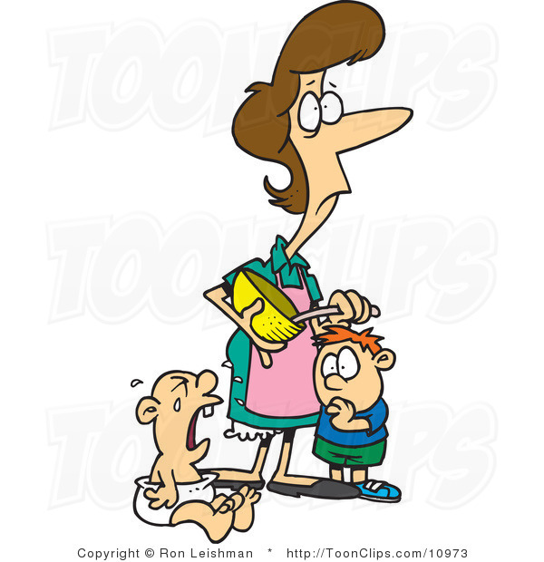
Inherent Flaws of Volunteer Management Committees
Requires a high level of diversified skills that are difficult to find in rural areas.
Corporate knowledge is continually lost
Working parents with young children who have high demands on their time.
High expectations on volunteers
Most of our Committee Members are busy young, working Mums

Slide 7
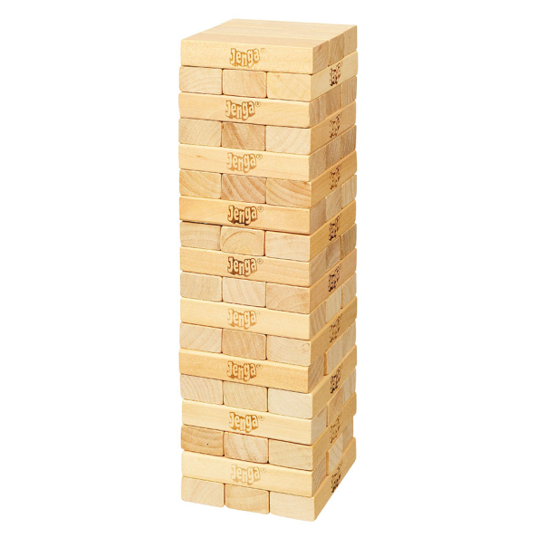



Jenga

Slide 8

Anyone want to take on all this responsibility?

Slide 9
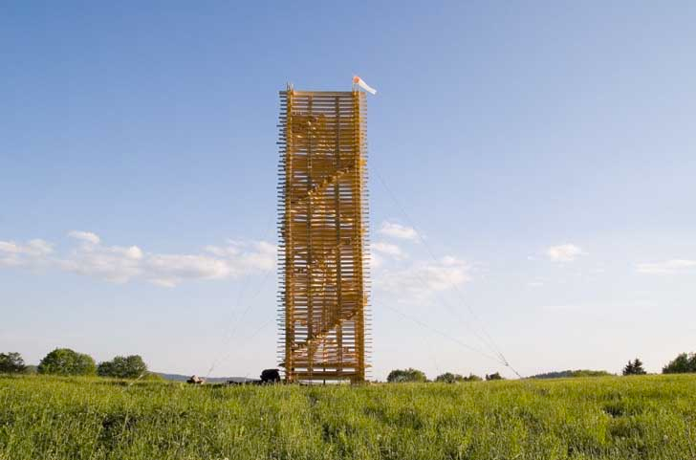
A New Model

Slide 10
Jill Cameron & Associates Report
Management Committee continues
Shire becomes Approved Provider
Existing Wheatbelt Organisation
New Incorporated Organisation
Already Established Larger Organisation

Slide 11

Lady Gowrie Tasmania
Community Based Not for Profit Organisation
Encompasses over 30 Services in Tasmania, including rural, remote, regional and inner city.
Governed by voluntary Board of Directors
CEO & Management team undertake day to day operational management
Includes small services which as stand alone services were unsustainable
Generates efficiencies through economies of scale

Slide 12
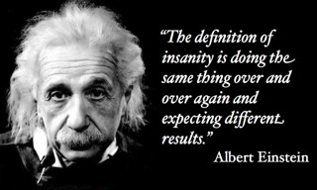
How we instigated change
Presentation at RDA Wheatbelt Conference
Forum for Service Providers, York
Lady Gowrie CEO presented their model at the workshop
Shire of Brookton agreed to be lead agency and apply for funding
Successful in obtaining funding
Jill Cameron and Associates recruited to undertake the project.

Slide 13
Project Consultants Jill Cameron & Associates
Ros Cornish
Jill Cameron
Michael White
Michelle Scott

Slide 14
Reference Group
Chairperson – Fleur Wilkinson
Mia Davies MP – Member for the Central Wheatbelt
Representatives from
Department of Education
RDA Wheatbelt
Wheatbelt Development Commission
Department of Local Government and Communities
Wheatbelt Organisation for Children’s Services
WALGA

Slide 15
Objectives of Project
Identify and understand cost structures and drivers
Develop a business model
Recommend a governance and operating structure
Develop a business case
Identify change management issues

Slide 16
Methodology
Collect and analyse data
Compare with services in the Lady Gowrie Tasmania Cluster model
Development of a region-wide cluster model tailored to the Wheatbelt
Consultation with stakeholders including funders and the project Reference Group
Communication with Shires, Management Committees and services throughout the project
Presentation of the proposed model to service providers.

Slide 18
Without the Commonwealth
Sustainability grants the deficits would be significantly higher than they currently are.

Slide 19
In most cases the income received in fees is less than the cost of paying the staff.

Slide 22
Possible Structure for Cluster Model
SKILLS & EXPERIENCE
Legal
Financial
Human Resources
Marketing /Communications
1 person from each of the three cluster areas
1 ECEC
1 School Education
Restructured Incorporated Entity
Service Advisory
Groups
Board
Finance Manager
Administrator
General Manager
Narrogin
153 places
Cluster Manager
Wongan Hills
196 places
Cluster Manager
Merredin
118 places
Cluster Manager
Services
467 places

Slide 23
OPPORTUNITIES
Sustain the community owned model
Supports service viability
Economy of scale
Eliminates duplication
Support for professional staff
Job security
Career path opportunities
Business development opportunities

Slide 24
Stage 2
Funding has been obtained
Obtaining formal agreement from services
Setting up “new” organisation
Pilot Cluster
Report and next phase planning
To be completed by 30 November 2016

Slide 25
Stage 3
Development of new business processes
Implementation of first cluster (Narrogin)
Review of all processes (lessons learned)
Refinement of processes
Implementation of following two clusters

Slide 26
Net Community Benefits Assessment
Undertaken by RPS Australia
Findings - “the proposed model is expected to provide significant and tangible benefits to the Wheatbelt region and more broadly across the state”.

Slide 27
Net Community Benefit Analysis Results
Impact | Net Present Value
Government Grant Savings | $1.3m
Children’s Health & Wellbeing | $31.6m
Workforce Participation | $32.6m
Total | $65.4m
Assumed growth in utilisation of 84 places
Assessed over 30 year period
Wheatbelt ranked 52 out of 60 regions across Australia for childhood development

Slide 28

Summary
Without change, services are at risk
Regional Collaboration
Importance of the early years
Outcomes for children, volunteers and communities
Other regions can apply for funding for a feasibility study

Slide 29
Acknowledgement
This presentation is based on projects commissioned by the Shire of Brookton and undertaken by Jill Cameron and Associates in 2015/16.
The willingness of Lady Gowrie Tasmania (LGT) to share details of the ‘LGT Cluster Model’ for assessment of its relevance to the Wheatbelt Region is gratefully acknowledged.
The Shire also acknowledges Lotterywest and the Department of Local Government and Communities for their ongoing support for the initiative and to Early Childhood Education and Care Services in the Wheatbelt Region for their enthusiastic participation in the project.

